Slide 1
Topic 7 Robot Perception

Slide 2
Autonomous mobile robots
autonomy
Vehicle
Actuators
Vehicle model
Sensors
Control
Vehicle autonomy
Path & motion planning
Localization
Perception
Independent from user
Localization & mapping
Independent from environment

Slide 3
Why should the roboticist understand instrumentation?
Key components for perceiving the environment
When you understand the instrumentations you can appropriately use sensors for robotics
Also, you can properly select or design a sensor for an application
Understanding instrumentations & measurements involves:
understanding the measurement system,
understanding the experiment,
understanding the data.

Slide 4
Instrumentation & measurements
Understanding the measurement system:
Sensors, signal conditioning, and output
Material properties, electronics, fluidics, heat transfer, mechanical properties, computer interface, modeling, control.
Understanding the experiment
What are we trying to measure?
What variables and parameters will affect my result?
Understanding the data:
How to interpret the measurements
Statistics and probabilities (random variables, uncertainty analysis, .. )

Slide 5

Understanding the measurement system
Sensor (Transducer)
Signal conditioning
Data acquisition
PC
Physical phenomenon
-Temperature
-Pressure
-Displacement
-Force
-Light
-Noise
-etc..
-Resistive
-Inductive
-Capacitive
-Light
-Magnetic
-Thermal
-Ultrasonic
etc..
-Amplification
-Linearization
-Excitation
-Isolation
-Averaging
-Filtering
-Modulation
etc..
-Analog multiplexer
-Instrumentation amplifier
-A/D, D/A conversion
-Sample clock
-Trigger
-Analysis
-Feedback control
-Display

Slide 6
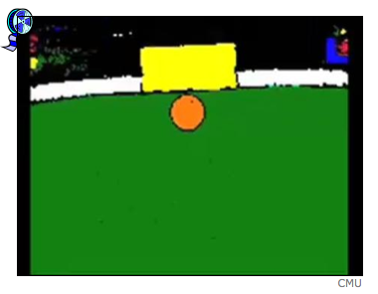
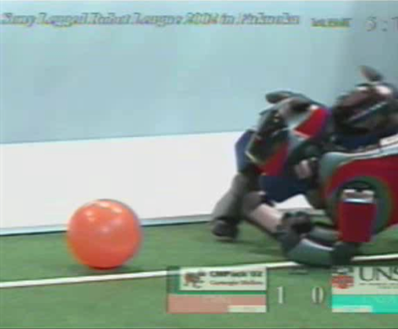
Example of a real world situation

Slide 7
Perception for mobile robots
Places/Situations
A specific room, meeting, situation, …
Functional/contextual relationship
imposed
learned
spatial/temporal
Objects
Doors, humans, car,…
Compressing information
Models
imposed
learned
Features
Lines, contours, colors, …
Models
imposed
learned
Raw Data
Vision, laser, sound, smell

Slide 8
Shakey the robot (1966-1972), SRI International
Operating environment
indoor
engineered
Sensors
wheel encoders
bump detectors
range finders
camera

Slide 9
Bibabot (2002), BlueBotics SA
Operating environment
Indoor and outdoor
on-road only
Sensors
wheel encoders
bumper
sonar sensors
laser range finders
inertial measurement unit
omnidirectional camera
pan-tilt camera

Slide 10
PR2 (2010-) Willow Garage
Operating environment
indoors and outdoors
on-road only
Sensors
wheel encoders
bumper
IR sensors
laser range finder
3D nodding laser range finder
Inertial measurement unit
pan-tilt stereo camera
pressure sensor and accelerometer inside hand
…

Slide 11
Sensor classification
Proprioceptive vs. exteroceptive
proprioceptive measure values internally to the system. examples include motor speed, wheel load, battery status,..
exteroceptive measure values externally to the system. Examples include sonars, laser range finders,..
Passive vs. active
passive measure energy coming from the environment (cameras, thermocouple,..)
active sensors emit their own energy and measure the reaction. Usually better performance but can react with the environment (laser range finders, sonars,..)

Slide 12
General classification (typical use) | Sensor | PC or EC | A or P
Tactile sensors (detection of physical contact or closeness; security switches | Contact switches, bumpers Optical barriers Noncontact proximity sensors | EC EC EC | P A A
Wheel/motor sensors (wheel/motor speed position | Brush encoders Potentiometers Synchros, resolvers Optical encoders Magnetic encoders Inductive encoders Capacitive encoders | PC PC PC PC PC PC PC | P P A A A A A
Heading sensors (orientation of the robot in relation to a fixed reference frame) | Compass Gyroscope Inclinometer | EC PC EC | A P A/P
A: active; P: passive; P/A: passive/active; PC: proprioceptive; EC: exteroceptive

Slide 13
General classification (typical use) | Sensor | PC or EC | A or P
Ground-based beacons (localization in a fixed reference frame) | GPS Active optical or RF beacons Active ultrasonic beacons Reflective beacons | EC EC EC EC | A A A A
Active ranging (reflective, time of flight, and geometric triangulation) | Reflective sensors Ultrasonic sensor Laser rangefinder Optical triangulation (1D) Structured light (2D) | EC EC EC EC EC | P P A A A
Motion/speed sensors (speed relative to a fixed or moving object) | Doppler radar Doppler sound | EC PC | A A
Vision-based sensors (visual ranging, whole image analysis, segmentation) | CCD/CMOS cameras Visual ranging packages Object tracking packages | EC | P
A: active; P: passive; P/A: passive/active; PC: proprioceptive; EC: exteroceptive

Slide 14
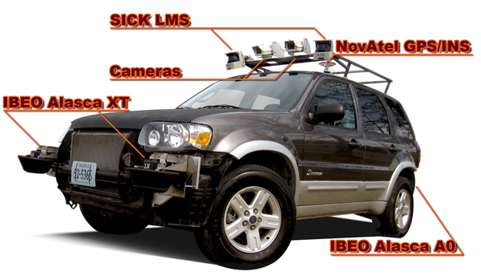
Sensors: example
Optical encoders
Heading sensors
compass
gyroscope
Accelerometers
IMU
GPS
Range sensors
sonar
laser
structured light
Vision

Slide 15
Encoders
Electro-mechanical device that converts linear or angular position or velocity to an analog or digital signal.

Slide 16
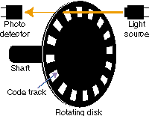
Rotary optical encoder
Consists of a rotating disc, a light source, a photodetector (light sensor).
The disc is mounted on the rotating shaft and has coded patterns of opaque and transparent slots.
As the shaft rotates, the pattern interrupts the light, thereby generating a digital pulse → determine speed.

Slide 17

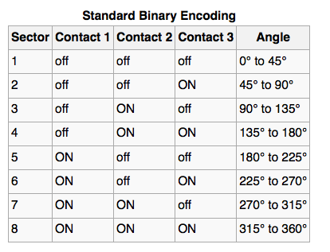
Rotary encoder (absolute)
- contact 1: inner ring
- black sectors are on
- zero on the right
- angle increases CCW

Slide 18
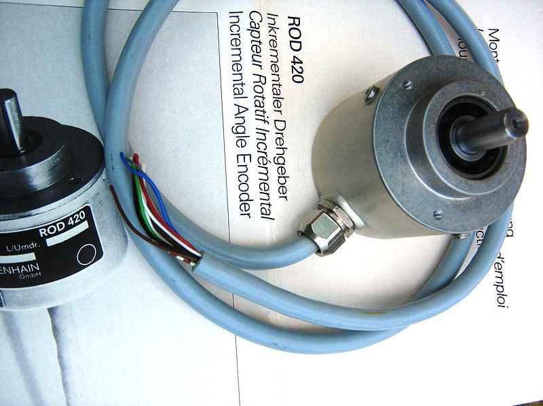
Incremental rotary encoder
Cyclic outputs only when the encoder is rotated.
The most widely used because of low cost and high precision (can find some with 10,000 counts/revolution)

Slide 19
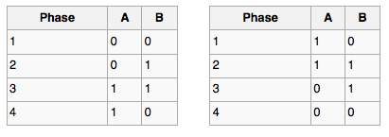
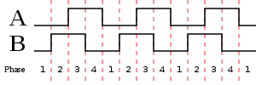
Incremental encoders
Incremental encoders track motion, velocity, and direction.
They use 2 outputs called quadrature outputs (90 degrees out of phase)
Clockwise rotation
Counter-clockwise rotation

Slide 20
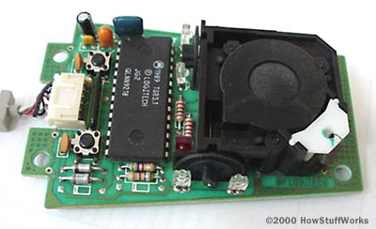
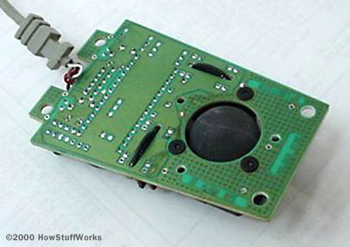
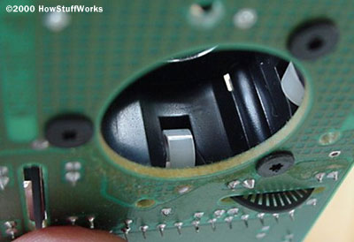
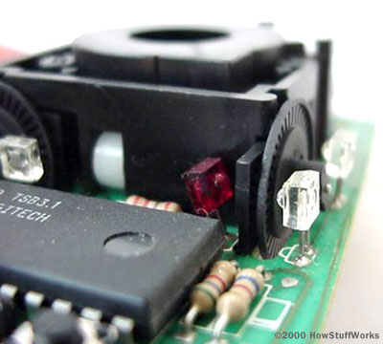
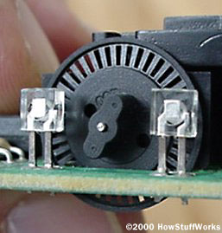
http://computer.howstuffworks.com/mouse2.htm

Slide 21
Heading sensor - Compass
Used since 2000 B.C.
when Chinese suspended a piece of natural magnetite from a silk thread and used it to guide a chariot over land
Magnetic field of Earth
absolute measure for orientation (even birds use it for migration)
Large variety of solutions to measure the Earth magnetic field
mechanical magnetic compass
gyrocompass
direct measure of the magnetic field (Hall-effect, magneto-resistive sensor)

Slide 22
Major drawbacks of compass
Weakness of the Earth magnetic field (30 μTesla)
Easily disturbed by magnetic objects or other sources
Bandwidth limitations (0.5 Hz) and susceptible to vibrations
Not suitable for indoor environment for absolute orientation

Slide 23
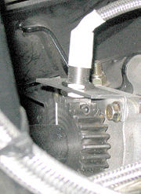
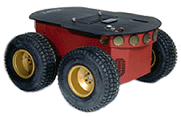
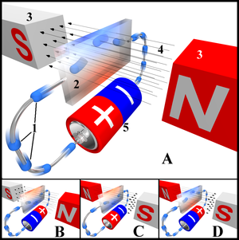
Hall effect - application
For robot odometry, a hall effect quadrature encoder senses gear teeth on the driveshaft in order to measure rotation.

Slide 24
Gyroscope
Heading sensors that preserve orientation in relation to a fixed reference frame
They provide absolute measure for the heading of a mobile system
Two categories including:
Mechanical gyroscopes
standard (angle)
rate gyro (speed)
Optical gyroscopes
rate gyro (speed)

Slide 25
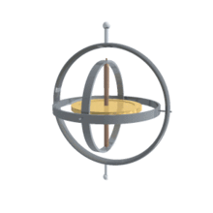
Mechanical gyroscopes
Concept
inertial properties of a fast spinning rotor
Angular momentum associated with a spinning wheel keeps the gyro inertially stable
No torque can be transmitted from the outer pivot to the wheel axis:
spinning axis is space-stable
friction in the bearings introduces
torque, which results in drift.
Quality:
0.1º drift in 6hours
high quality can cost up to
100,000$

Slide 26
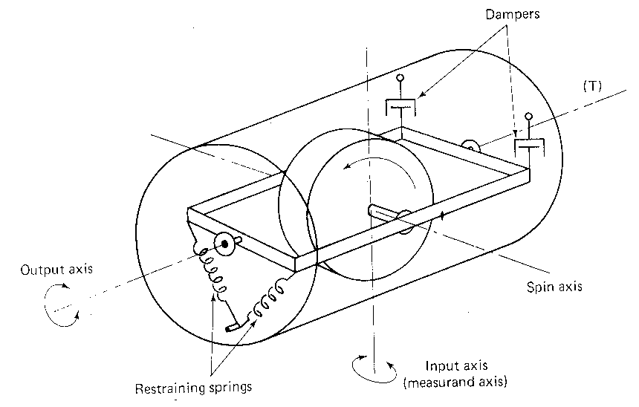
Rate gyro
Same basic principle as a regular mech. gyro
However: gimbals are restrained by torsional springs
This enables measuring angular speeds instead of orientation

Slide 27
Mechanical accelerometer
Accelerometers measure all external forces acting upon them, including gravity
Accelerometers act like a mass-spring-damper system
mass
viscous damping
stiffness
At steady-state:

Slide 28
Mechanical accelerometer
On the Earth’s surface, the accelerometer always indicates 1g, along the vertical axis
To obtain the inertial acceleration (due to motion alone), the gravity must be subtracted. Conversely the device’s acceleration is zero during free fall
Bandwidth up to 50KHz
An accelerometer measures acceleration along a single axis. By mounting 3 accelerometers orthogonally to one another, a 3-axis accelerometer is obtained

Slide 29
MEMS accelerometer
Operational principle
The primary transducer is a vibrating mass that relates acceleration to displacement
The secondary transducer (capacitive divider) converts the displacement to electric signal)
Main characteristics
can be multi-directional
Sensing ranges from 1 to 50g
Applications
dynamic acceleration
Static acceleration (inclinometer)
Airbag sensor (+-35g)
video games (Wii)

Slide 30
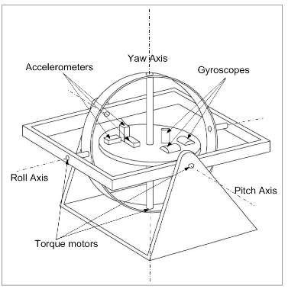
Inertial Measurement Unit (IMU)
An inertial measurement unit consists of three mutually orthogonal accelerometers and gyroscopes, intended to work together to measure linear accelerations and angular velocities.

Slide 31
IMU
In order to estimate motion, the gravity vector must be subtracted.
IMUs are extremely sensitive to measurement errors in gyroscopes and accelerometers
drift in gyroscopes unavoidably undermines the estimation of the vehicle orientation relative to gravity, which results in incorrect cancellation of the gravity vector.
Because the accelerometer data is integrated twice to obtain the position, any residual gravity vector results in a quadratic error in position
After a ‘long’ period of operation ALL IMUs drift. To cancel it some external reference like GPS is required.

Slide 32
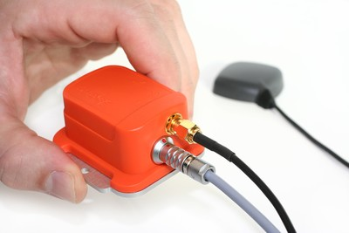
Inertial Navigation System (INS)
An Inertial Navigation System (INS) integrates information from several sources in order to better its estimate of the motion of a platform.
For example, the Xsens MTI-G implements an Extended Kalman Filter (EKF) to integrate the information it acquires from a GPS, a compass, a pressure sensor, and a tilt sensor.

Slide 33
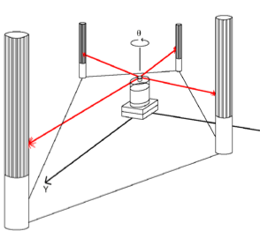
Ground-based active & passive beacons
Elegant way to solve the localization problem in robotics
Beacons are signaling guiding devices with a precisely known position
Beacon-based navigation is used since the humans began travelling:
Natural beacons (landmarks) like stars, mountains or the sun
Artificial beacons like lighthouses

Slide 34
Ground-based active & passive beacons
Global Positioning System (GPS) revolutionized modern navigation technology
Major drawbacks with the use of beacons indoor:
Beacons requires changes in the environment
Limit flexibility and adaptability to changing environments

Slide 35
Global Positioning System (GPS)
GPS became accessible for commercial applications in 1995
24+ satellites orbiting the Earth every 12 hours at a height of 20.19 km
4 satellites are located in each of 6 orbits with 60 degrees orientation between each other
Working principle: location of any GPS receiver is determined through a time of flight measurement (satellites send orbital location (ephemeris) + time). The receiver computes its location through trilateration and time correction.

Slide 36
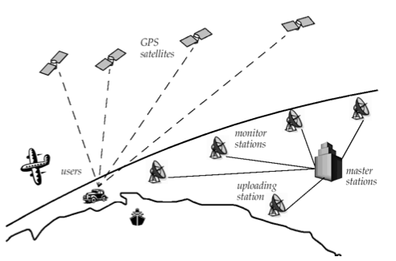

Slide 37
Differential Global Positioning System (dGPS)
dGPS requires that a GPS receiver, known as base station, be set up on a precisely known location. The base station receiver calculates its position based on satellite signals & compares this location to the known location. The difference is applied to the GPS data recorded by the roving GPS.
Position accuracies in sub-meter to cm range

Slide 38
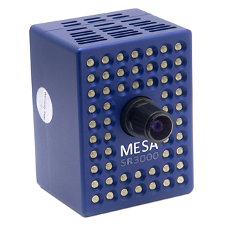
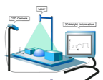
Range sensors
Sonar
Laser Range Finder
Time of flight camera
Structured light

Slide 39
Range sensor (time of flight)
Large range distance measurement → thus called range sensors
Range information
Ultrasonic sensors as well as laser range sensors make use of propagation speed of sound or electromagnetic waves respectively
The travelled distance of a sound or electromagnetic wave is:
distance traveled (round trip)
speed of wave propagation
time of flight

Slide 40
Range sensor (time of flight)
It is important to point out:
Propagation speed v of sound: 0.3m/ms
Propagation speed v of electromagnetic signals: 0.3m/ns (1 million x faster). Measuring time of flight not easy here. LRF are expensive and delicate.
The quality of time of flight range sensors mainly depends on:
Inaccuracies in the time of flight measurement (LRF)
Opening angle of transmitted beam (especially ultrasonic range sensors)
Variation of propagation speed (sound)
Speed of mobile robot and target (if not at standstill)

Slide 41
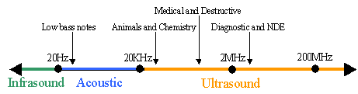
Ultrasonic range sensor
Ultrasound is a sound with a frequency greater than the upper limit of human hearing (20KHz).
Ultrasonic ranging is performed by measuring the difference in time between the emitted and reflected wave.

Slide 42
Ultrasonic range sensor
Operational principle:
ultrasonic pulse is generated by a piezoelectric emitter, reflected by an object, and sensed by a piezo-electric receiver. Speed of sound in the air and time of flight allow one to measure the distance to the object.
Main characteristics
Precision influence by angle to object
Useful in ranges from several cm to several meters. Relatively inexpensive
Applications
distance measurement
collision detection

Slide 43
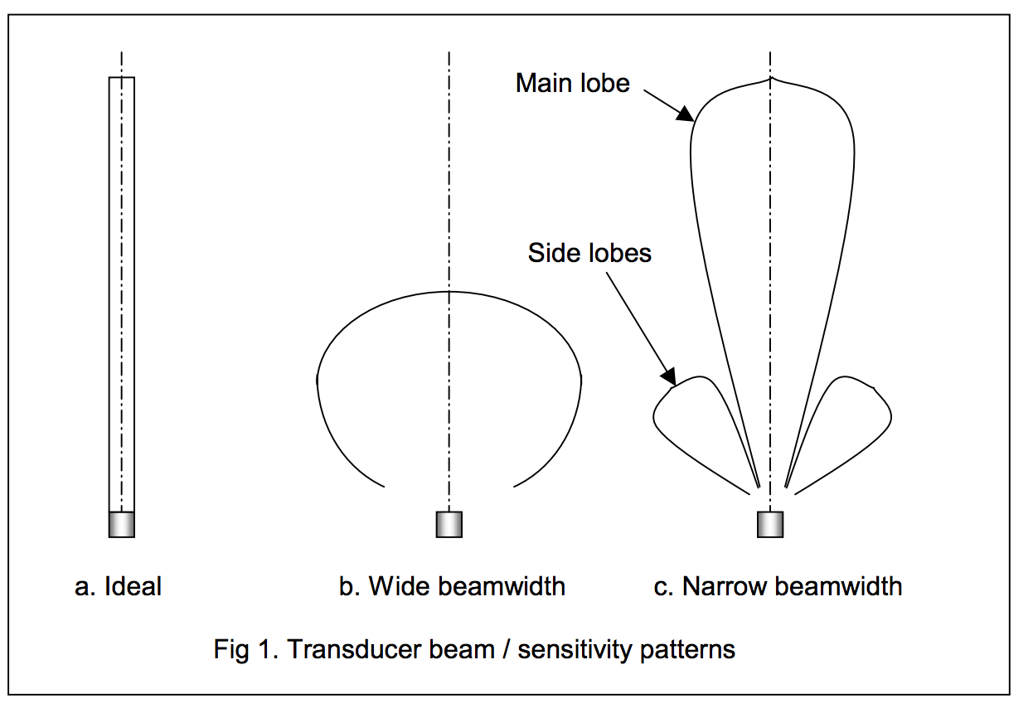

Slide 44
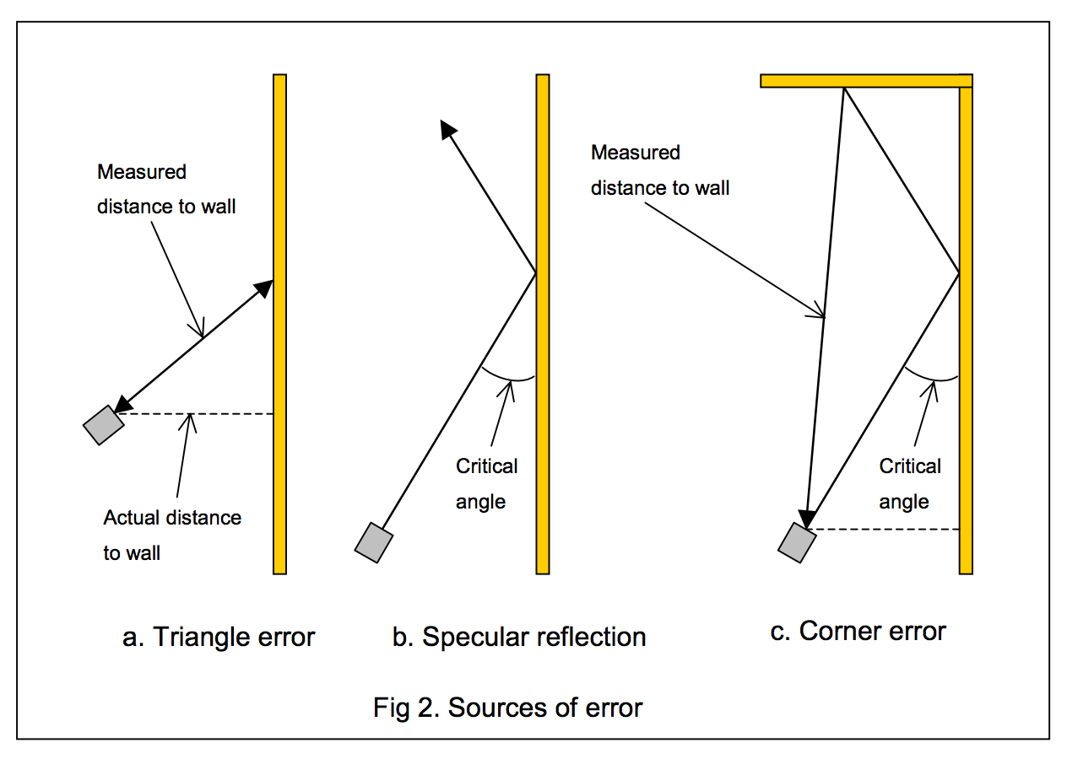

Slide 45
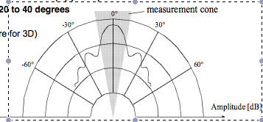
Ultrasonic sensor
Typical frequency: 40kHz – 180kHz
Transmitter and receiver can be separated or not.
Range between 12cm to 5m
Accuracy 98%→ relative error 2%
Sound beam propagates in a cone (20 to 40 degrees opening angle)

Slide 46
Ultrasonic sensor (time of flight)
Bandwidth:
Measuring the distance to an object that is 3m away will take such a sensor 20ms, limiting its operating speed to 50Hz. If the robot has a ring of 20 ultrasonic sensors. Each firing sequentially and measuring to minimize interference between the sensors, then the ring’s cycle time becomes 0.4 s → frequency of each sensor = 2.5Hz.
This update rate can have a measurable impact on the maximum speed possible while still sensing and avoiding obstacles safely.

Slide 47

Infrared emitter/receiver
Infra red radiation is a electromagnetic radiation of wavelength longer than that of visible light but shorter than radio waves.

Slide 48
Laser Range Sensor (time of flight)
Laser range finders are also known Lidars (Ligth Detection And Ranging)

Slide 49
Laser Range Finder

Slide 50
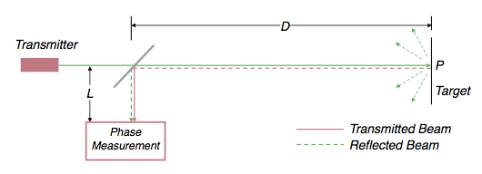
LRF - Operating principles
Pulsed laser
Measurement of elapsed time directly
resolving picoseconds
Phase shift measurement to produce range estimation
technically easier than the above method

Slide 51
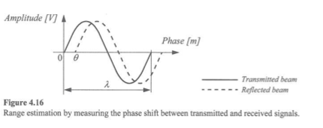
LRF – phase shift measurement
Where:
c is the speed of light;
f is the modulating frequency;
D’ is the distance covered by the emitted light
for f = 5MHz, λ = 60 meters

Slide 52
LRF – phase shift measurement
Distance D, between the beam splitter and the target
Where:
θ is the phase shift between transmitted and reflected beam
Theoretically ambiguous range estimates
Since for example if λ = 60 m, a target at a range of 5m = target at 35m.

Slide 53
LRF issues
Uncertainty of the range (phase/time elapsed) is inversely proportional to the square of the received amplitude.
Hence dark, distant objects will not produce such good range estimates as closer brighter objects

Slide 54
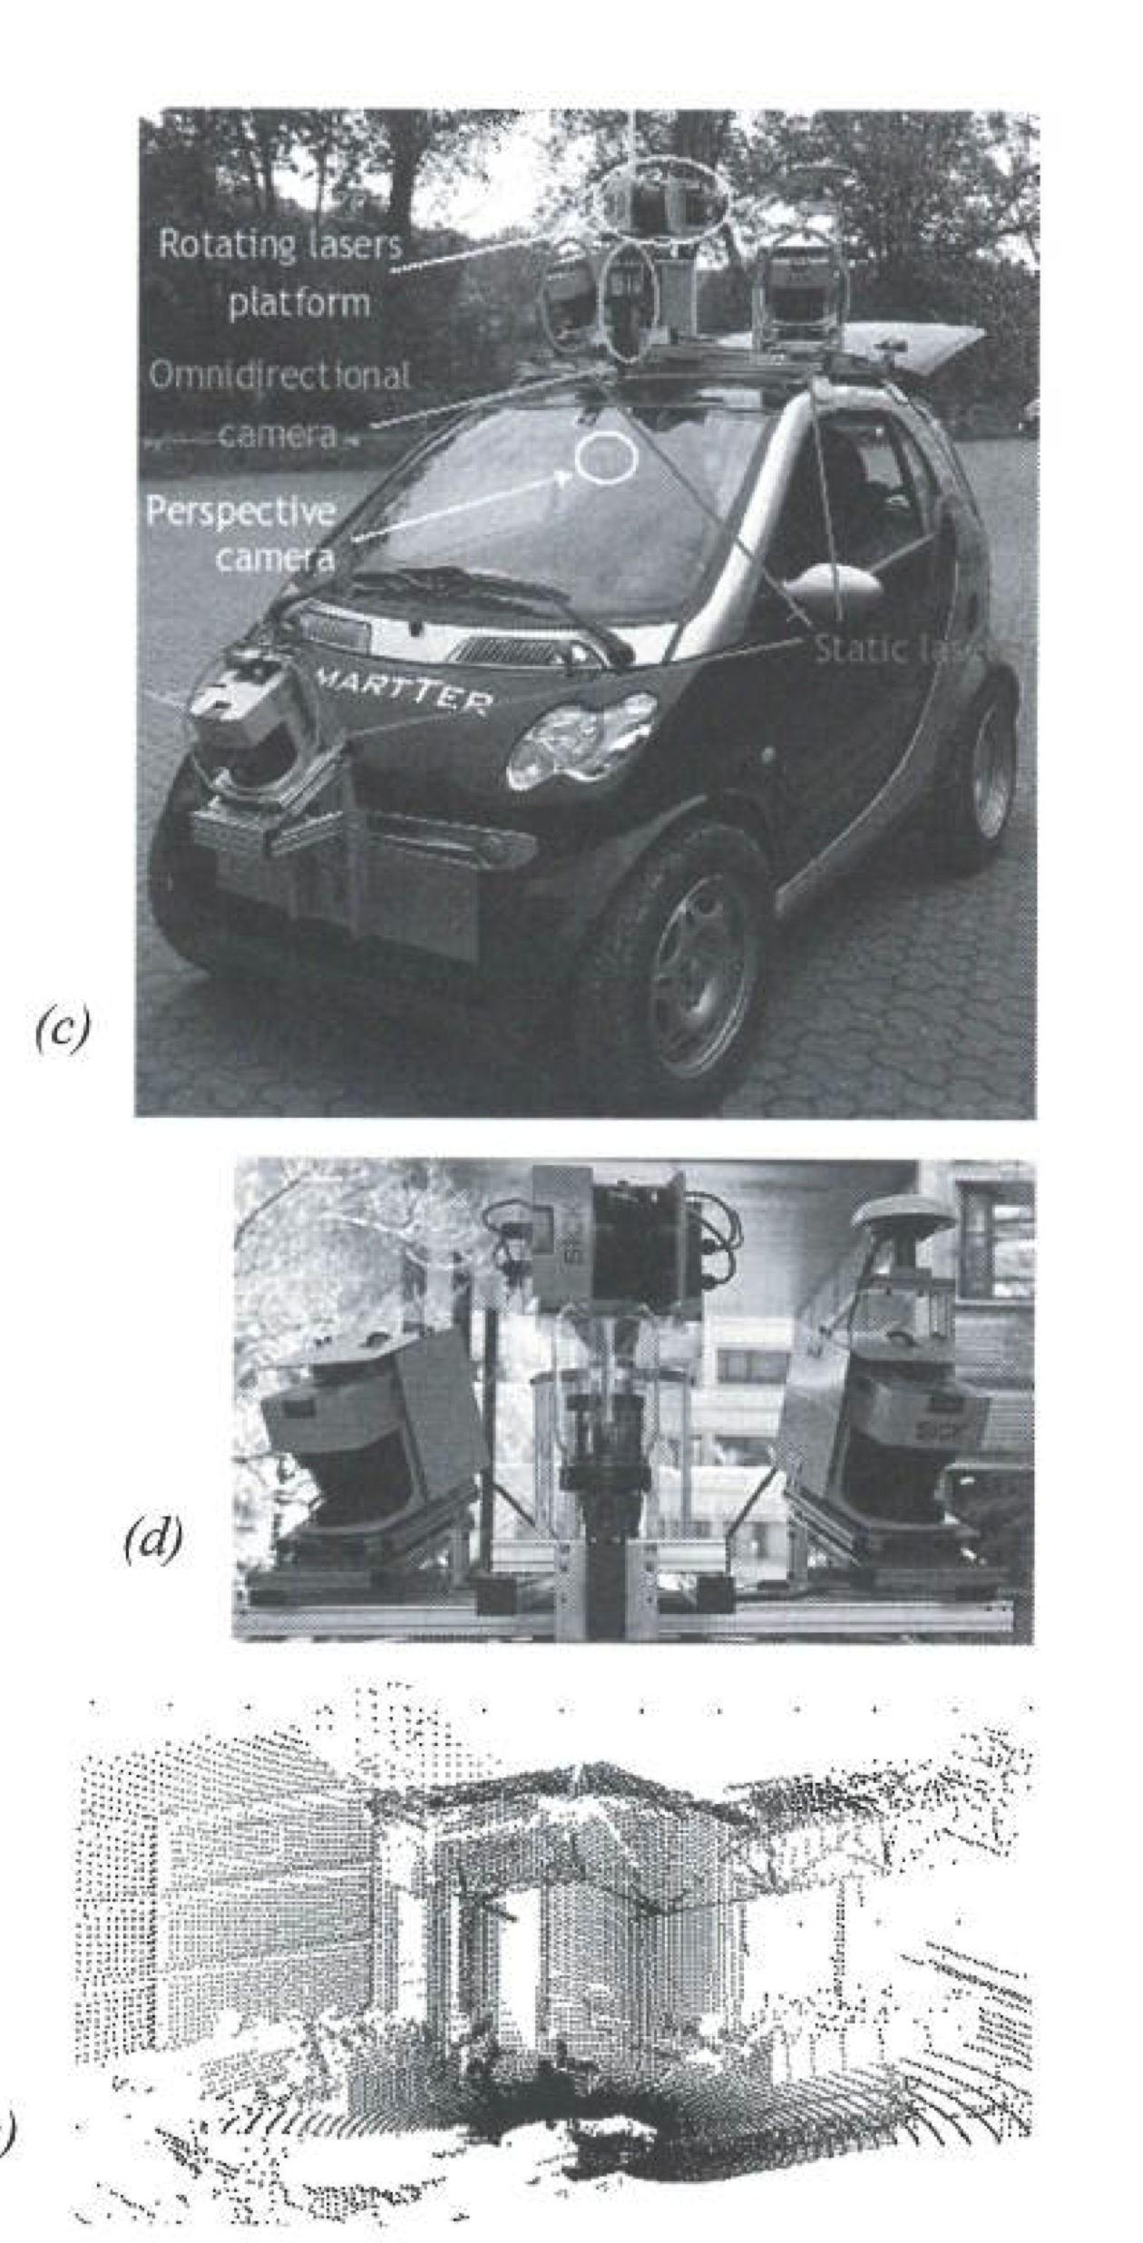
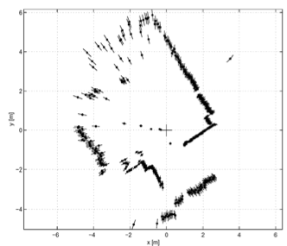
LRF typical images
The length of the lines through the points indicate uncertainties

Slide 55
The SICK LMS200 Laser Scanner
Angular resolution of 0.25 deg.
Depth resolution between 10 and 15mm. Typical accuracy is 35mm, over a range from 5cm to 20 m, depending on the reflectivity of the object being ranged.
Seventy five 180-degrees scans per second.

Slide 56
3D laser range finder
a 3D laser range finder is a laser that acquires scan data in more than a single plane.
Custom made 3D scanner are made by mounting a scanner on a pan-tilt unit. A full spherical view can be covered.
However acquisition takes up to some seconds
For example, with a laser taking 75 scans/sec, and an azimuthal angular resolution of 0.25 degrees, the period for a rotation of a turntable is:
360/0.25/75=19.2s

Slide 57
3D laser range finder
The Velodyne HDL-64E uses 64 laser emitters (~50,000 Euros)
turn rate up to 15 Hz
360º field of view in azimuth & 26.8º in elevation
Angular resolution is 0.09º and 0.4º respectively
Delivers over 1.3 million data points/second
Distance accuracy > 2cm and can measure depth up to 50m.

Slide 58
Laser range finder
The Alasca XT laser scanner splits the laser beam into 4 vertical layers with an aperture angle of 3.2º.
This sensor is typically used for obstacle and pedestrian detection on cars. Because of its multi-layer scanning principle, it allows us any pitching of the vehicle.

Slide 59
3D range sensor: time of flight
A time of flight camera works similar to a LIDAR with the advantage that the whole 3D scene is captured a the same time and there are no moving parts. It uses a modulating infrared lighting source to determine the distance for each pixel of a photonic mixer device

Slide 60
Incremental Object part detection
3D information with high data rate (100Hz)
Compact & easy to manage
High, non-uniform measurement noise
High outlier rate at jump edges
VERY low resolution (174x144 pixels)

Slide 61
Triangulation ranging
Use of geometric properties of the image to establish a distance measurement
If a well defined light pattern (e.g., point, line) is projected onto the environment:
reflected light is then captured by a photo-sensitive line of matrix (camera) sensor device.
simple triangulation allows to establish a distance

Slide 62
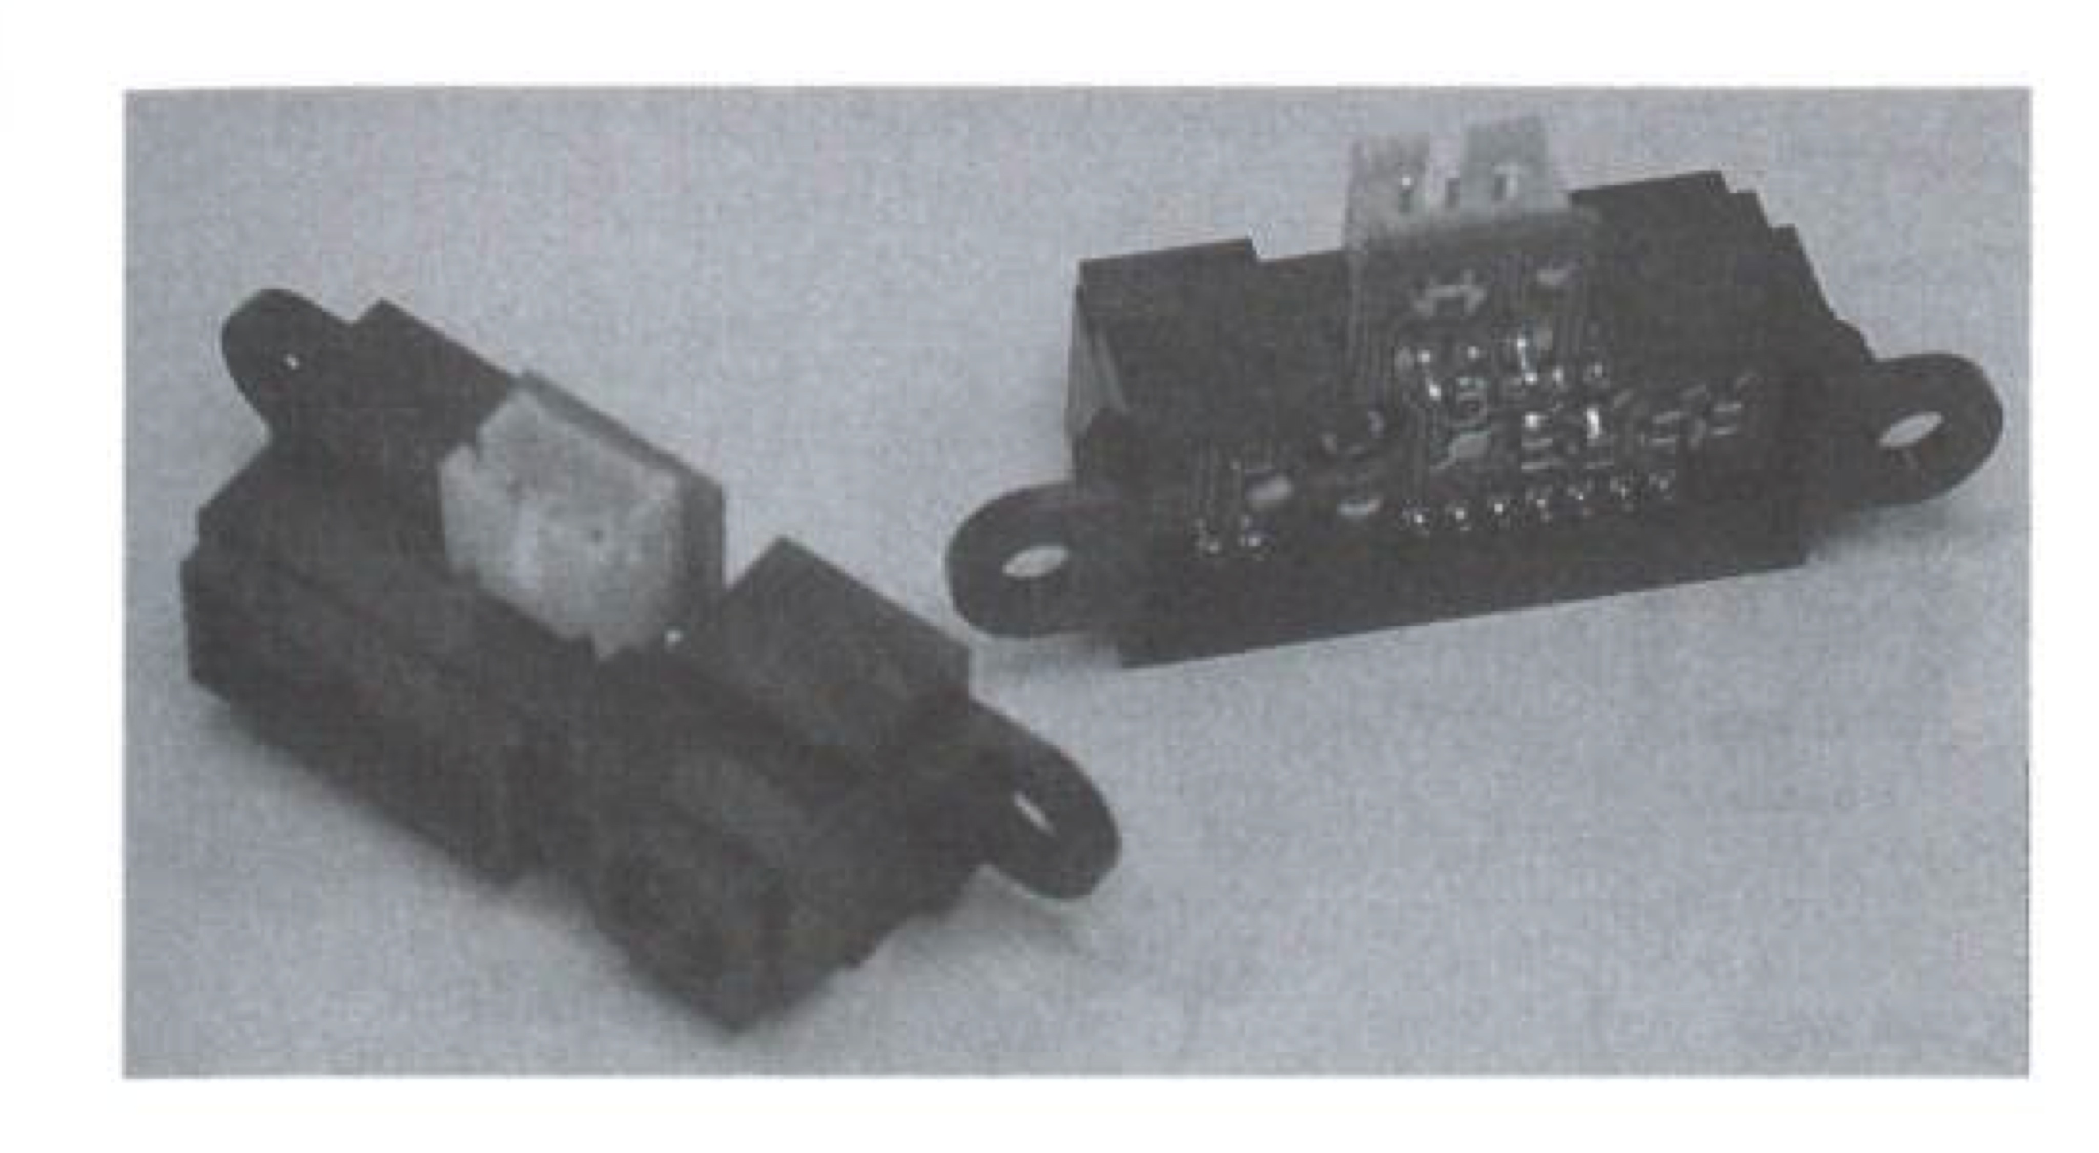
Triangulation ranging
Infrared range finder are cheaper than ultrasonic
High bandwidth
Does not suffer from cross-sensitivity
Limited range --- between 8cm and 80cm
Sharp GP range sensor

Slide 63
Laser triangulation (1D)
Principle of 1D laser triangulation:

Slide 64
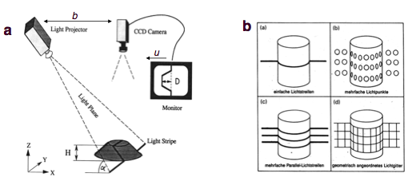
Structured light (Kinect)
Eliminates the correspondence problem by projecting structured light on the scene.
Slits of light or emit collimated light (possibly laser) by means of a rotating mirror.
Light perceived by camera
Range to an illuminated point can then be determined from geometry

Slide 65
Sensor static characteristics
Accuracy
Calibration
Errors
Precision
Sensitivity
Gain
Full scale input & output
Dynamic range

Slide 66
Sensor static characteristics
Threshold
Resolution
Response
Response time
Precision
Linearity
****Repeatability
****Uncertainty

Slide 67
Measurement models

Slide 68
Measurement models
Environment measurement models comprise the second domain-specific model in probabilistic robotics, next to motion models.
Measurement models describe the formation process by which sensor measurement are generated in the physical world.
The specific model depends on the sensor.
Cameras are best modeled by projective geometry
Sonars are best modeled by modeling the propagation and reflection of pressure waves.

Slide 69
Sensor models
The sensor models account for the inherent uncertainty in the robot’s sensors.
The measurement model is defined as a conditional probability distribution:
robot pose
reading
map

Slide 70
Sonar Range Scan

Slide 71
Sensor noise
The inability of a sensor to reliably measure range to nearby objects is paraphrased as sensor noise.
For sonar this noise is quite predictable (specular surfaces).
The likelihood of this to happen depends on:
surface material,
the angle between surface normal and the direction of the sensor cone.
the range of the surface
the width of the main sensor cone

Slide 72
Sensor models
The response characteristics of a sensor depend on variables we prefer not to make explicit since we could not model them for all situations (surface type of a wall).
Probabilistic robotics accommodates inaccuracies of sensor models by:
modeling the measurement process as a conditional probability density p(z_{t}|x_{t}) instead of a deterministic function
the uncertainty of the model can be accommodated in the non-deterministic aspect of the model.
In practice we can get away with extremely crude models.

Slide 73
Sensor models
Most sensors generate more than one numerical measurement value when queried.
Cameras generate arrays of values.
Range finders generate entire scans of ranges.
The probability of a given scan is given by:
assuming independence

Slide 74
Maps
A map of an environment is a list of objects in the environment and their locations.
The value m_{n} contains, next to the properties of a feature, its Cartesian location.
Maps are usually indexed in one of two ways:
Feature-based
Location-based

Slide 75
Maps
In feature-based maps, n is a feature index (1,2,…n,… features)
In location-based maps the index n corresponds to a specific location
In planar maps, it is common to denote a map element by m_{x,y}, to make explicit that m_{x,y} is the property of a specific world coordinate (x, y).
Location-based maps are volumetric, which contain information about the presence AND absence of objects.

Slide 76
Maps
Feature-based maps only specify the shape of the environment at the specific locations. They are popular in the robotic mapping field.
A classical map representation is known as occupancy grid map. These are location-based maps. They assign to each x-y coordinate a binary occupancy value that specifies whether or not a location is occupied.
Occupancy grid maps make it easy for a robot to find paths through the unoccupied space.

Slide 77
Measurement model 1 Beam models of range finders
Range finders measure the range to nearby objects.
We present here a model for a range finder that incorporates four types of measurement errors:
Small measurement noise
Errors due to unexpected objects
Errors due to failure to detect objects
Random unexpected noise
The desired model p(z_{t}|x_{t},m) is a mixture of four densities.

Slide 79
Pseudo-density of a mixture distribution

Slide 80
Correct range with local measurement noise
Even if a sensor correctly measures the range to the nearest object, the value it returns is subject to error.
The error is due to:
limited resolution of range sensors
atmospheric effect on the measurement signal
The measurement noise is modeled by a narrow Gaussian with:
mean
Standard deviation

Slide 81
Measurement noise
The measurement probability is given by:
Found through ray casting

Slide 82
Ray casting

Slide 83
Unexpected objects
Since objects can be dynamic, objects not contained in the map can cause range finders to produce bizarre results (moving people).
One way to deal with this is to treat them as part of the state vector and estimate their position.
Another approach is to treat them as sensor noise. In this case they would cause readings to be shorter.
The likelihood of sensing unexpected objects decreases with range.

Slide 84
Unexpected objects
The probability of having such a object (or short reading) is:
The cumulative probability is given by:
η is found as:

Slide 85
Failures
Sometimes obstacles are missed altogether. Examples include sonars measuring specular objects, or lasers sensing black, light absorbing objects, or in bright sunlight.
A sensor error is returned as a max-range measurement (z_{max})
This will be modeled as a point-mass distribution:

Slide 86
Random measurements
Range finders occasionally produce entirely unexplained measurements (phantom sonar readings, when bouncing off a wall).
These measurements are modeled by a uniform distribution spread over the entire sensor measurement range.

Slide 87
Final measurement model
These four distributions are mixed by a weighted average, defined by z_{hit}, z_{short}, z_{max} and z_{rand}

Slide 88
Pseudo-density of a mixture distribution

Slide 89
Measurement model

Slide 90
Adjusting the intrinsic model parameters
Several question arise at this point.
How do we chose the mixing parameters z_{hit}, z_{short}, z_{max}, and z_{rand}?
Other parameters include σ_{hit} and λ_{short}
We refer to the set of parameters as Θ
One way to estimate these parameters is to rely on experimental data.

Slide 91
Range data (expected 3m)

Slide 92
Adjusting the parameters
One way to do it is manually.
Another way is by maximizing the likelihood (ML estimator) of a referenced data set Z={z_{i}} with associated positions X={x_{i}} and map m:
Our goal is to identify Θ that maximizes this likelihood of measurements.
We call this the maximum likelihood estimator

Slide 94
Results

Slide 95
Learned sensor model in action

Slide 96
Results with likelihood plots

Slide 97
Practical considerations
In practice computing the densities for all sensor readings can be quite involved and can not always be carried out in real time.
One approach to solve this problem is to incorporate only a subset of all measurements (e.g., 8 laser readings instead of 360)
The added advantage is that the state estimation process becomes less susceptible to correlated noise in adjacent measurements (since they become further away)
When dependencies between adjacent measurements are strong the ML model may make the robot overconfident and yield suboptimal results.

Slide 98
Limitations of the beam model
The beam-based sensor model suffers from 2 major drawbacks:
It exhibits a lack of smoothness. In cluttered environments the distribution p(z_{t}|x_{t},m) can be unsmooth in x_{t}.
In cluttered environments (like many chairs with many legs) have a large effect on the correct range of a sensor beam. As a result the heading direction is particularly affected.
k

Slide 99
Limitations of the beam model
The beam-based model is computationally involved.
This is largely due to the ray tracing issue

Slide 100
Measurement model 2 Likelihood fields for range finders
This is an alternative model, which overcomes the above limitations.
It is an ad-hoc method but it works well in practice.
The resulting posterior is smoother and the computation is more efficient.

Slide 101
Likelihood fields for range finders
The resulting posterior is smoother and the computation is more efficient.
The key idea is to project the end points of a sensor scan z_{t} into the global coordinate space of the map. For this we need:
Transformation between the global and robot coordinate frame x_{t} = (x y θ)^{T}
Where on the robot, the sensor beam originates: (x_{k,sens} y_{k,sens})^{T}
The direction the sensor points: θ_{k,sens}

Slide 102
Likelihood fields
The end point of the measurement is then mapped into the global coordinates as:
These coordinates are only meaningful when the sensor detects an obstacle.
If the range sensor takes on a maximum value z_{t} = z_{max}, these coordinates have no meaning in the physical world, so it it simply discarded
k

Slide 103
Three types of noise
Measurement noise: noise is modeled as a Gaussian. This involves finding the nearest obstacle in the map:
Failures: as before, we assume the max-range readings have a distinct large likelihood p_{max}.
Unexplained random measurements: a uniform distribution p_{rand} is used here.
Now we can write:

Slide 104
Likelihood fields for range finders

Slide 105
Likelihood fields. Probability as a function of measurement

Slide 106
Likelihood fields for range finders

Slide 107
Extensions

Slide 108
Extensions
A key advantage of the likelihood field model over the beam-based model is smoothness.
Due to the smoothness of the Euclidean distance, small changes in the robot pose x_{t} only have small effects on the resulting distribution p(z_{t}|x_{t},m)
However the current model has three disadvantages:
k

Slide 109
Disadvantages
It does not explicitly model people and other dynamics that might cause short readings.
It treats sensors as if they can see through walls (ray casting replaced by a nearest neighbor function). It can not detect if a path is intercepted by an obstacle.
The approach does not take map uncertainty into account. It cannot handle unexplored areas, where the map is uncertain. We can address this issue by sorting map occupancy into three categories (occupied, free, and unknown), instead of just the first two

Slide 110
Measurement model 3 Correlation-based
There exists a number of range sensor models in the literature that measure correlations between a measurement & map.

Slide 111
Correlation-based measurement models
A common technique is known as map matching.
Typically, map matching consists of compiling small numbers of consecutive scans into local maps (m_{local})
The sensor measurement model compares the local map to the global map m (these are occupancy maps).
The more similar m and m_{local} the larger p(m_{local}|x_{t},m)
We first project the local map to the coordinates of the global map.

Slide 112
Correlation-based cont..
Once they are in the same reference frame, we compare using the map correlation function:
average map value
# of elements in the overlap
Finally:

Slide 113
Map matching
It easy to compute, though it does not yield smooth probabilities in pose parameters x_{t}.
One way to approximate the likelihood field is to convolve the map with a Gaussian smoothness kernel and run map matching on this smoothed map.
One advantage over likelihood fields is that is explicitly considers the free-space in the scoring of two maps.
The likelihood field technique only considers the end point of the scans, which corresponds to occupied space (or noise).

Slide 114
Measurement model 4 Feature-based measurement models
Instead of counting raw sensor data, an alternative approach is to extract features from measurements f(z_{t}).

Slide 115
Feature-based measurement models
Most feature extractors extract a small number from a high dimensional space.
Of course the advantage here is the enormous reduction of computational complexity.
For range sensors, it is common to use lines, corners, or local minima in range scans (correspond to walls, corners, or objects).
When a camera is used (computer vision) popular features include edges, corners, distinct patterns, SIFTs, SURFs, …
In robotics it is common to define places as features such as hallways and intersections.

Slide 116
Landmark measurements
In many robotics applications, features correspond to distinct objects.
For example in indoor environments features may be door posts, or windowsills. Outdoor could be tree trunks or corners of buildings.
In robotics it is common to call such objects landmarks, to indicate they are being used for robot navigation.
The most common model for processing landmarks assumes that the sensor can measure the range and bearing of the landmark relative to the robot’s local coordinate frame.
Such sensors are know as range and bearing sensors

Slide 117
Feature vectors
A signature of a landmark is a numerical value such as an average color around it.
A feature vector is usually referred to as:
range
bearing
signature
Many probabilistic robotic algorithms assume conditional independence between features:

Slide 118
Measurement model
The feature location with respect to the robot is given by:
zero-mean Gaussian error

Slide 119
Sensor model with known correspondence
A known problem for range/bearing sensors is known as data association.
The problem arises when landmarks can not be uniquely identified. We introduce at this point a correspondence variable (denoted c_{t}) between a feature f_{t} and a landmark m_{j} in a map.
If c_{t} = j ≤ N, then the i^{th} feature observed at time t corresponds to the j^{th} landmark in the map.
i
i
i
i

Slide 120
Sensor model with known correspondence
-θ

Slide 121
Sampling poses
Sometimes it is desirable to sample robot poses x_{t} that correspond to a measurement f_{t} with feature identity c_{t}.
To sample robot pose we have to make further assumptions. In particular we want to know the prior p(x_{t}| c_{t}, m). For simplicity we will assume this prior as uniform.
We then use Baye’s rule:
i
i
i

Slide 122
Sensor model with known correspondence

Slide 123
Sensor model with known correspondence

Slide 124
Further considerations
Both algorithms for landmark-based measurements assume known correspondence. Unknown correspondence will be discussed later.
The main reason for using features is computational: a few hundred instead of a few million.
With the advent of fast computers, features have gradually lost importance in the field of robotics.
Instead most state of the art algorithms use dense measurement vectors. They also use dense location-based maps to represent the environment.

Slide 125
Practical considerations
Models discussed here are only representatives of a much broader class of probabilistic models.
In choosing the right model, it is important to trade off physical realism with properties that might be desirable for an algorithm using these models.
As a general rule of thumb, the more accurate a model, the better.
The more information we can extract from the sensor measurement, the better.
Feature-based models extract relatively little information (high-dimensional space projected to low-dimensional space)

Slide 126
Practical considerations
Feature-based methods tend to produce inferior results. The disadvantage is offset by superior computational properties of feature-based representations.
When adjusting the intrinsic parameters of a measurement model it is often useful to artificially inflate the uncertainty.
This is done because to make probabilistic techniques computationally tractable, we have to ignore dependencies that exist in the physical world.
When such dependencies are not modeled, algorithms that integrate evidence from multiple measurement quickly become overconfident.

Slide 127
Practical considerations
Overconfidence can ultimately lead to wrong conclusions, which negatively affects the results.
It is therefore a good rule of thumb to reduce the information conveyed by a sensor.
Doing so by projecting the measurement into a low-dimensional feature space is one way of achieving this.
A better way is to uniformly decaying the information by exponentiating a measurement model with a parameter α, in that it does not introduce additional variance in the outcome of a probabilistic algorithm.

